Slide 1
Conditional and Loop Statements
Conditional and Loop Statements
Presented By : Nitish Vig

Slide 2
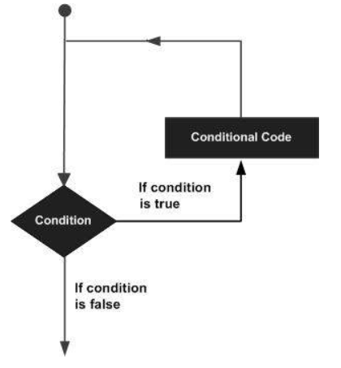
Basics
Every programming language have Conditional and Loop Statements.
It helps to evaluate various conditions check before implementing a task.
Conditional and Loop Statements
Presented By : Nitish Vig

Slide 3
In Python we can achieve decision making by using the following statements:
if statements
if-else statements
elif statements
Nested if and if-else statements
elif ladder

Slide 4
If Statement : if Statement is used to run a statement conditionally i.e. if given condition is true then only the statement given in if block will be executed.
Syntax:-
if <expression>:
<statement>

Slide 5
if-else statements:- The statement itself says if a given condition is true then execute the statements present inside the “if block” and if the condition is false then execute the “else” block. Syntax: If (EXPRESSION ): Statement (Body of the block) else: Statement (Body of the block)

Slide 6
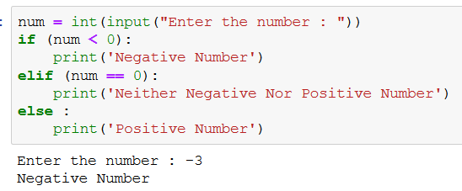
If-elif- Else
Syntax : if expression :
statements
elif expression :
statements
else :
statements
It checks the condition before implementing a task,
and,
that is implemented once.

Slide 7
Nested if-else statements Nested “if-else” statements mean that an “if” statement or “if-else” statement is present inside another if or if-else block. Nested if Syntax: if(condition): #Statements to execute if condition is true if(condition): #Statements to execute if condition is true #end of nested if #end of if

Slide 8
Nested if-else Syntax: if(condition): #Statements to execute if condition is true if(condition): #Statements to execute if condition is true else: #Statements to execute if condition is false else: #Statements to execute if condition is false

Slide 9
elif Ladder
if (condition): #Set of statement to execute if condition is true elif (condition): #Set of statements to be executed when if condition is false and elif condition is true elif (condition): #Set of statements to be executed when both if and first elif condition is false and second elif condition is true elif (condition): #Set of statements to be executed when if, first elif and second elif conditions are false and third elif statement is true else: #Set of statement to be executed when all if and elif conditions are false

Slide 10
Loop Types : For loop While loop

Slide 11
The range() Function
The range() function returns a sequence of numbers, starting from 0 by default, and increments by 1 (by default), and ends at a specified number.
for x in range(6): print(x)
Note :- range(6) is not the values of 0 to 6, but the values 0 to 5.
for x in range(2, 6): print(x)
Note:-which means values from 2 to 6 (but not including 6):
for x in range(2, 30, 3): print(x)
Note:-Increment the sequence with 3 (default is 1)

Slide 12
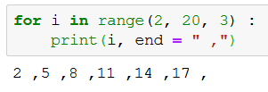
For Loop
For loops are used for sequential traversal. For example: traversing a list or string or array etc.
Syntax:
for iterator_var in sequence: statements(s)
It checks the condition before implementing a task,
and,
if found TRUE, it repeats in a loop with defined limits.

Slide 13
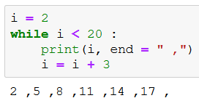
While Loop
Syntax : while expression :
statement
It checks the condition before implementing a task,
and,
if found TRUE, it repeats in a loop with defined limits.

Slide 14
Using else statement with while loops:
while loop executes the block until a condition is satisfied. When the condition becomes false, the statement immediately after the loop is executed.
count = 0
while (count < 3):
count = count + 1
print("Hello ")
else:
print("In Else Block")
while condition:
# execute these statements
else:
# execute these statements

Slide 15
Problem statement
Q 1: Print First 10 natural numbers using while loop
Q2:WAP to print table of a number
Q3: Calculate the sum of all numbers from 1 to a given number
Q4: Count the total number of digits in a number
Q5: Reverse a given integer number
Q6:Sum of digit of a number
Q7:Armstrong Number
Q8:Palindrome number
Q9: Fibonacci series
Q10:Cube in a range

Slide 16
Control statements
Control Statements :
Break
Continue
Pass
Conditional and Loop Statements
Presented By : Nitish Vig

Slide 17
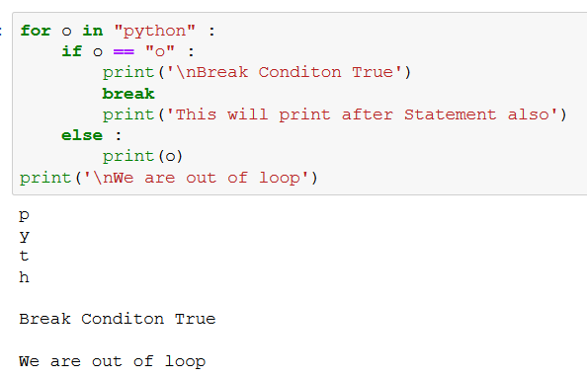
Break
Syntax : if expression :
statements
break
else :
statements
It checks the condition before implementing a task,
and, if found True,
it will skip the current statement of loop structure and get of the whole loop.
Conditional and Loop Statements
Presented By : Nitish Vig

Slide 18
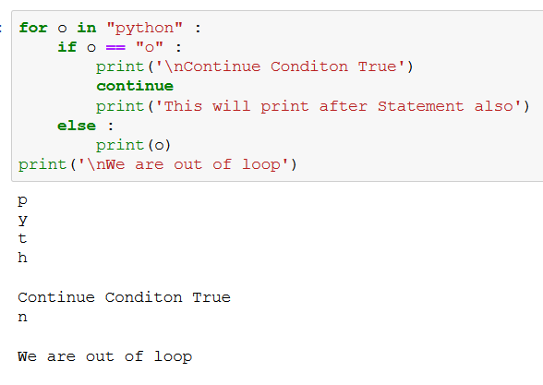
Continue
Syntax : if expression :
statements
continue
else :
statements
It checks the condition before implementing a task,
and, if found True,
it will skip the current statement of loop structure and implement other conditions.
Conditional and Loop Statements
Presented By : Nitish Vig

Slide 19
Pass
Syntax : if expression :
statements
pass
else :
statements
a = 10 b = 20 if(a<b): pass else: print("b<a")
The pass statement is a null statement. But the difference between pass and comment is that comment is ignored by the interpreter whereas pass is not ignored.
It will do nothing.
It is used by programmer to acknowledge that the program is running correct.
Presented By : Nitish Vig

